Slide 1
JORDAN REGULATORY FRAMEWORK FOR REVIEW AND ASSESSMENT
PARTICIPANTS: -RAHAF ABABNEH
-ABED ALLAH BANI-YASIN
ENERGY & MINERALS REGULATORY COMMISSION (EMRC)

Slide 2
Introduction
EMRC aims to achieve and maintain a high level over the safe use of nuclear energy through legislation, review, inspection and licensing in the Jordan for the protection of human and environment.
EMRC is responsible for preparing the legislative framework for workers and facilities in the nuclear energy sector, as well as reviewing and evaluating the safety documents of nuclear installations and facilities In addition to carrying out the tasks of field inspection of nuclear facilities through a qualified and trained inspection team.

Slide 3
Legal framework
EMRC is responsible for preparing laws, regulations and instructions for the safe use of nuclear energy based on the basic principles and requirements of nuclear safety, nuclear security, emergency and nuclear safeguards published by the International Atomic Energy Agency(IAEA) and the best international practices, to ensure that the activities and facilities are under EMRC regulations through the issuance of licenses or permits necessary for Installations/ Facilities or individuals.

Slide 4
Cont.
The current enforced law for Radiation and Nuclear Materials, Facilities and Activities; Radiation Protection, and Nuclear Safety and Security Law no. (43) for the year 2007 was revised.
A number of Articles were added to accommodate nuclear power program.

Slide 5
Cont.
Energy and Minerals Regulatory Commission (EMRC) proposed the below remarks to be addressed in the new nuclear Law:
  Assigning prime responsibility for safety to the operator.
  Provision for appeals against decisions of the regulatory body.
  Provision for nuclear or radiological emergency preparedness & Response.
  Criteria for release from regulatory control.
  Jurisdiction for Inspectors.
  Involvement of stakeholders and their input in the regulatory decision making process.

Slide 6
The regulation “Safe Use of Nuclear Energy”
The regulation “Safe Use of Nuclear Energy” issued in April 2014.
The regulation “Safe Use of Nuclear Energy” is covering: Authorization, Responsibility for safety, radioactive waste and spent fuel management, orphan radioactive sources and nuclear material, Safeguards, Physical Protection, Emergency Planning and Preparedness (on-site and off-site), inspection, enforcement, Administrative Sanctions , liability and Punishments.
According to Jordan’s Legislative framework, the law is issued after the approval of Cabinet and the Parliament upon the competent authority’s recommendation, and implemented after being published in the official gazette.

Slide 7
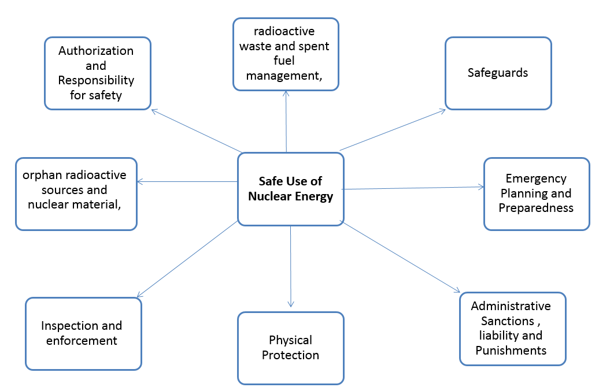

Slide 8
EMRC Instructions related to RR
Instructions for granting licenses and permits for Sub-critical Assemblies.
Safety instructions for research reactor.
Decommissioning Instructions for nuclear installations and facilities.
Instructions for the requirements of nuclear safety, security and radiation protection to be adopted in the organizational structure of research reactors.
Instructions for licensing specialized training, qualification and personal licenses in research reactors.

Slide 9
Review and Evaluation
EMRC review and evaluate the documents submitted from the licensee for the purpose of issuing: permits, licenses or evaluation to verify that the licensee follows the highest standards of safety in the design, construction, assembly, analysis, operation ... etc. of nuclear facilities.
And so this is done through several stages covering the lifetime of the nuclear facility from the stage of site selection, construction, and commissioning, operation and decommissioning.
EMRC also review and evaluate the reports of incidents or accidents that may occur in nuclear facilities in order to ensure the sustainability of the safety of those facilities for continues operation.

Slide 10
Inspection
EMRC carry out inspection missions in relation to all regulated activities to ensure compliance of licensees with the applicable legislation and any other conditions set out in the license / permit requirements. Inspection mission shall be carried out to ensure the conformity of the information set out in the application in the permit or license with the real situation.
Inspection missions are also carried out for the purposes of verifying the continuous compliance of the licensee to the applicable legislation and binding conditions.

Slide 11
Law enforcement
In accordance with Law No. 7 of 2017, the law of Energy and Minerals Regulatory Commission, EMRC inspectors have the authority of the judicial authority, which allows them to establish legal proceedings when conducting inspections or verification on nuclear facilities, or nuclear practices under the umbrella of the law.

Slide 12
Acceptance Criteria
According to the licensing policy signed in 2011 , the basis for drafting the SAR’s was NUREG-1537 part1 : “ Preparing and Reviewing Applications for the Licensing of Non-Power Reactors”.
As an acceptance criteria we used NUREG 1537, Part 2: Reviewing Applications for the Licensing of Non-Power Reactors: Standard Review Plan and Acceptance Criteria
By using the NUREG 1537, Part 2 in addition to the IAEA GS-G-1.2 , we can say that we followed a graded approach on review and assessment of the facility

Slide 13
Licensing of jrtr
Licensing of JRTR is an example of EMRC approach for authorization of nuclear facilities. Several safety review rounds, Request for Additional Information (RAIs) third Party Opinions and Witness activities were performed. Further Progress Review Meetings with Korea Institute of Nuclear Safety (KINS) and with TSO, inspections and witness have been conducted since 2010. Many inspection mission conducted on the JRTR project, where the inspection extends to the operator, designer, constructor and subcontractors, in addition to the daily and reaction inspections conducted by EMRC and its resident inspectors in the JRTR site.
For that, EMRC signed a cooperation agreement with the Korea Institute of Nuclear Safety (KINS). Also EMRC consulted a US advisory body (ADSTM) to provide technical assistance for the purpose of reviewing, evaluating and analyzing the reactor safety documents as well as carrying out inspection tasks during the construction process to verify compliance with applicable legislation, requirements and special conditions for the permit.
After completion of the construction phase, the JRTR started the commissioning stage in 2015 and loading of nuclear fuel in 2016, that’s after verifying the licensee had met all the requirements of nuclear safety, radiation protection, nuclear security, emergency and nuclear safeguards through the evaluation and analysis and the implementation of inspection tasks.
In addition, the individuals who are the senior operators and operators of the research reactor have been authorized through conducting theoretical and practical examinations and interviews to ensure the qualification of the candidates. After passing the success mark for each part of the evaluation process, personal licenses were issued.

Slide 14
Cont.
EMRC granted Operation License (OL) on November 15th, 2017. This construction permit was given as a result of a two years of authorization process of JRTR application, including:-
Receiving OL application: FSAR, EIA, QA program and other supplementary documents.
Conducting 1st, 2nd and follow-up rounds of Request of Additional Information (RAIs) between EMRC’s technical team and applicant.
Missions with IAEA to get advices on some critical issues.
Several meetings between EMRC, applicant, and its contractors.
Meetings with Korean regulator, TSO (AdSTM) for consultations.
Conducting several Inspections and Witness activities.
Missions with European Union experts to get third party independent opinion.
Commissioning Stages

Slide 15
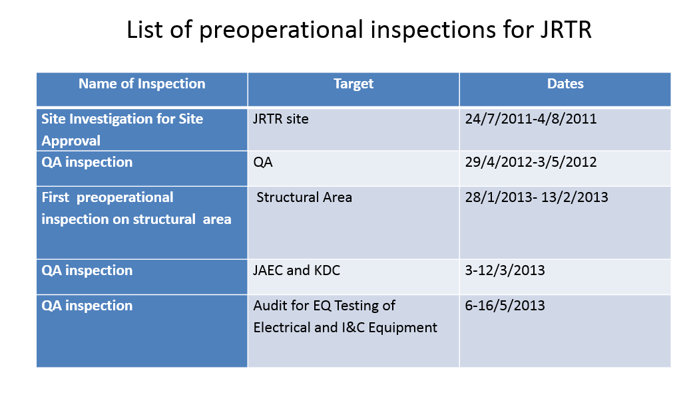

Slide 16
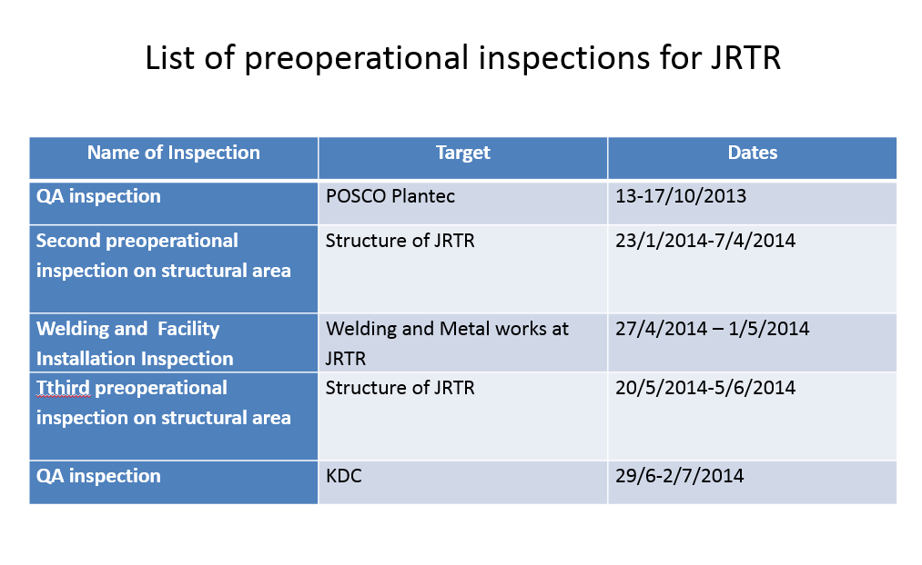

Slide 17
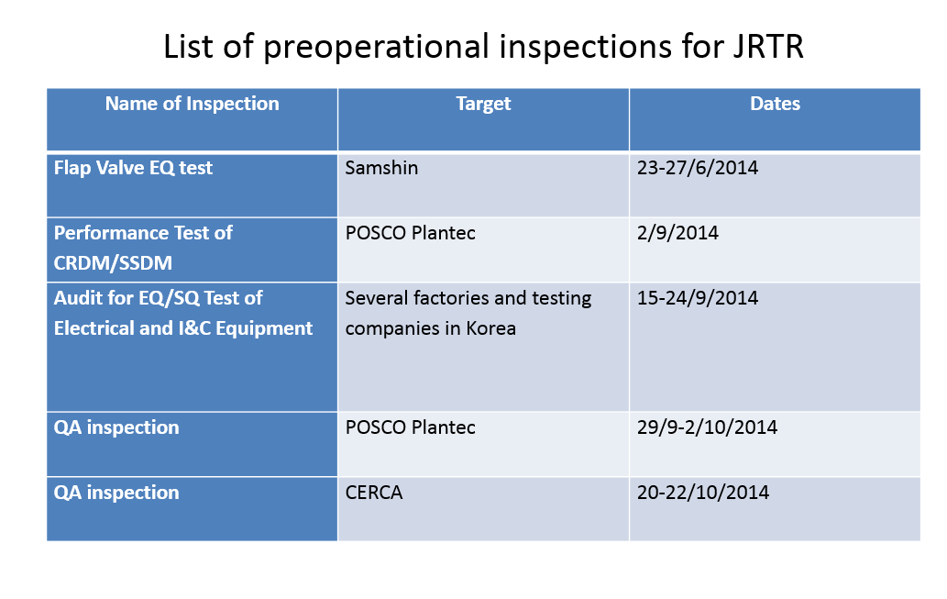

Slide 18
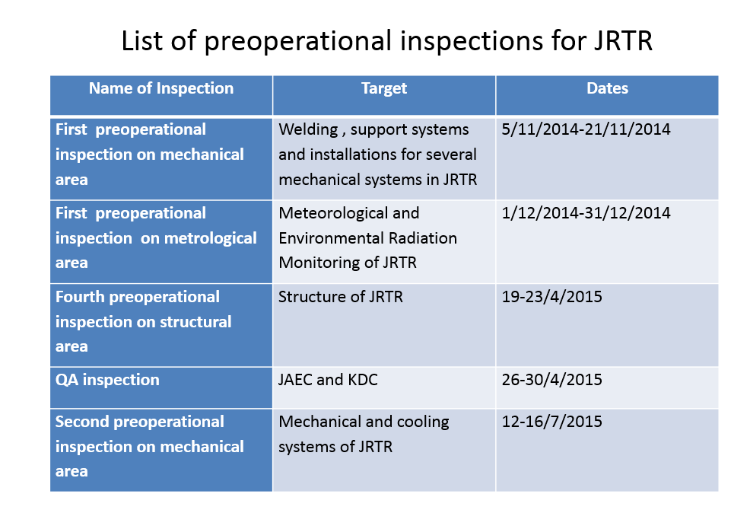

Slide 19
