Slide 1
National practices in Regulatory Review and Assessment of Research Reactors
Kazakhstan
Orazgaliyev Nurkhat
Institute of Atomic Energy and Institute of nuclear physics
Engineer in the Experiments’ preparation and conduction service of CRR “Baikal-1”

Slide 2

Regulatory body
The state safety regulatory bodies are independent of other state bodies, as well as of organizations whose activities are related to use atomic energy.
The main tasks of the Committee are:
- implementation of state policy in the field of the electric power industry and using atomic energy;
- implementation of other tasks assigned to the Committee, within its competence..
The Committee for Atomic and Energy Supervision and Control

Slide 3
National Legislation applied to research reactors
The main regulations on which the process of control and supervision, as well as licensing are based:
Law of the Republic of Kazakhstan “On the Use of Atomic Energy”;
Law of the Republic of Kazakhstan “On Permits and Notifications”;
Law of the Republic of Kazakhstan "On radiation safety of the population"
Technical Regulations "Nuclear and Radiation Safety"
Technical Regulations "Nuclear and Radiation Safety of Research Nuclear Installations";
Decommissioning rules for nuclear and radiation installations;
Qualification requirements for personnel employed at nuclear facilities;
Rules of certification of personnel engaged in nuclear facilities;
National Plan for Responding to Nuclear and Radiation Accidents;
Regulations and standard of public services in the field of atomic energy use;
Rules for the examination of nuclear, radiation and nuclear security.

Slide 4
The role of the review and assessment in licensing
Licensing is the main instrument of state regulation of safety, monitoring of compliance with existing rules and regulations of nuclear and radiation safety, which is necessary in aim of the ensuring national security, protection environment, property, life and health of citizens.

Slide 5

Review and safety assessment
State control and supervision on objects of atomic energy use consists of three main elements:
- Review and Preventive control and supervision;
- Licensing;
- Review of nuclear and radiation safety and nuclear security
.
Licensing | Review and Preventive control and supervision | Expertise of nuclear, radiation and nuclear physical safety
Licensing is the main instrument of state regulation of safety, monitoring of compliance with existing rules and regulations of nuclear and radiation safety, which is necessary in aim of the ensuring national security, protection environment, property, life and health of citizens. | Review of subjects implementing activity with nuclear installations of I and II category of potential radiation hazard is held by Regulatory Body on a periodic bases, but not frequent than one time in one quarter and unscheduled. | Review of nuclear and radiation safety and of nuclear security shall be carried out for independent assessment of the safety of nuclear installations, radiation and electro physical installations of radiation hazard categories 1 and 2, transport packages for the entire period, during which they may pose a potential hazard.

Slide 6
Review and safety assessment
Preventing control and supervision of subjects (objects) of control and supervision are precautionary.
Preventing control and supervision of subjects (objects) of control and supervision in the field of atomic energy use are held by analysis of:
Information and reporting provided in accordance with the requirements of the legislation of the Republic of Kazakhstan in the field of atomic energy use;
Information obtained by the inquiry of Regulatory Body on issues of observation of the legislation of the Republic of Kazakhstan in the field of atomic energy use within its competence – in case of receipt of information about the violation of the legislation;
Information from third parties relative to issues of observation of the legislation of the Republic of Kazakhstan in the field of atomic energy use.

Slide 7
Review and safety assessment
Procedure of review subjects, implementing activity with nuclear installations and objects of I and II category of potential radiation hazard
Review on periodical basis is the review appointed by CAESC with intent of prevention and (or) elimination of immediate threat of life and health of population, environment, legitimate interests of natural and juridical person and State.
Unscheduled review is the review appointed by CAESC on the concrete facts and circumstances giving rise to the appointment of the review against a specific subject of supervision with intent of prevention and (or) elimination of immediate threat of life and health of population, environment, legitimate interests of natural and juridical person and State.

Slide 8
проверка и оценка безопасности
Procedure of review subjects, implementing activity with nuclear installations and objects of I and II category of potential radiation hazard
The grounds for unscheduled inspection are::
information on changes in systems, equipment, documentation of a nuclear installation relating to ensuring nuclear, radiation or nuclear security;
information on accidents and incidents related to nuclear, radiation and nuclear physical security;
appeals of individuals and legal entities on issues of violation of the legislation of the Republic of Kazakhstan in the field of atomic energy use.

Slide 9
проверка и оценка безопасности
Procedure of review subjects, implementing activity with nuclear installations and objects of I and II category of potential radiation hazard
The operating organizations constantly monitor the state of nuclear and / or radiation safety at the nuclear power plant. Enterprises and organizations operating nuclear installations send weekly reports on the state of safety to an authorized body.
Periodically (at least 1 time per year), an order of the administration of the Nuclear and Radiation Protection Authority appoints an internal commission to check the state of nuclear and / or radiation safety at the Nuclear Energy Agency. According to the results of the audit, an act of commission is drawn up and approved. One copy of the approved act is sent to the authorized body no later than February 1, following the reporting year.

Slide 10
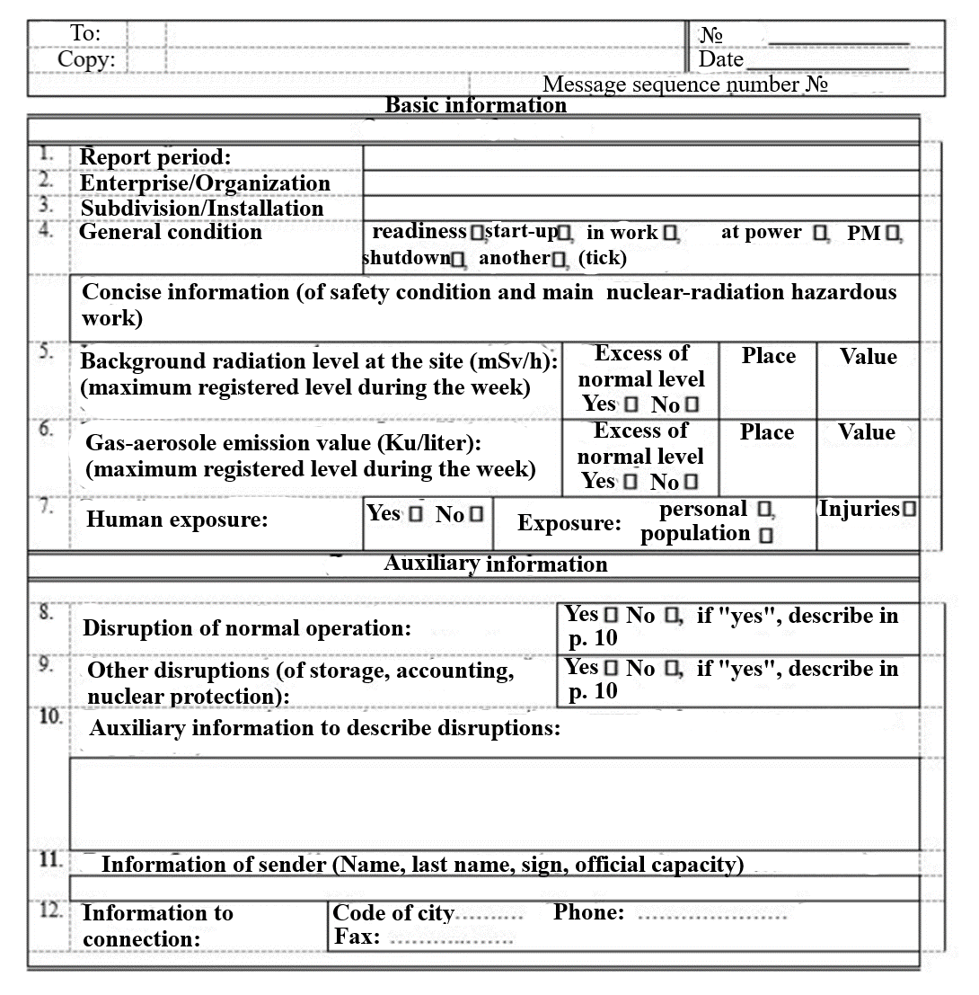
Form of the weekly report

Slide 11
Licensing
Licensing of activities in the field of atomic energy use is carried out in accordance with the Law of the Republic of Kazakhstan “On the Use of Atomic Energy” and the legislation of the Republic of Kazakhstan “On Permits and Notifications”.
Term of consideration of an application for a license and / or application to a license for activities: performance of work related to the stages of the life cycle of nuclear facilities for nuclear installations of categories 1 and 2 of radiation hazard, disposal points no more than ten months.

Slide 12
Process of licensing
The process of issuing a license is carried out in accordance with the regulations and the standard of State services in the field of the use of atomic energy
Since the receipt of the documents of the legal entity (hereinafter referred to as the service recipient), CAENC (service provider) checks the completeness and validity of the submitted documents. If the fact of incompleteness is established and the validity of the submitted documents expires, the service provider within two working days gives a reasoned refusal to further consider the application.
The form of the provision of public services is electronic.
The form of providing the result of the provision of public services is electronic.

Slide 13
Process of licensing
The list of documents required for the provision of public services when contacting the service recipient:
To obtain a license and / or license attachment:
application of the legal entity for obtaining a license and (or) attachment to the license;
an electronic copy of the document confirming the payment of the license fee to the budget for the right to engage in certain types of activities;
electronic copies of documents to the activities related to the implementation of work related to the stages of the life cycle of nuclear facilities (THE LIST OF DOCUMETS WILL BE IN ANNEX).

Slide 14
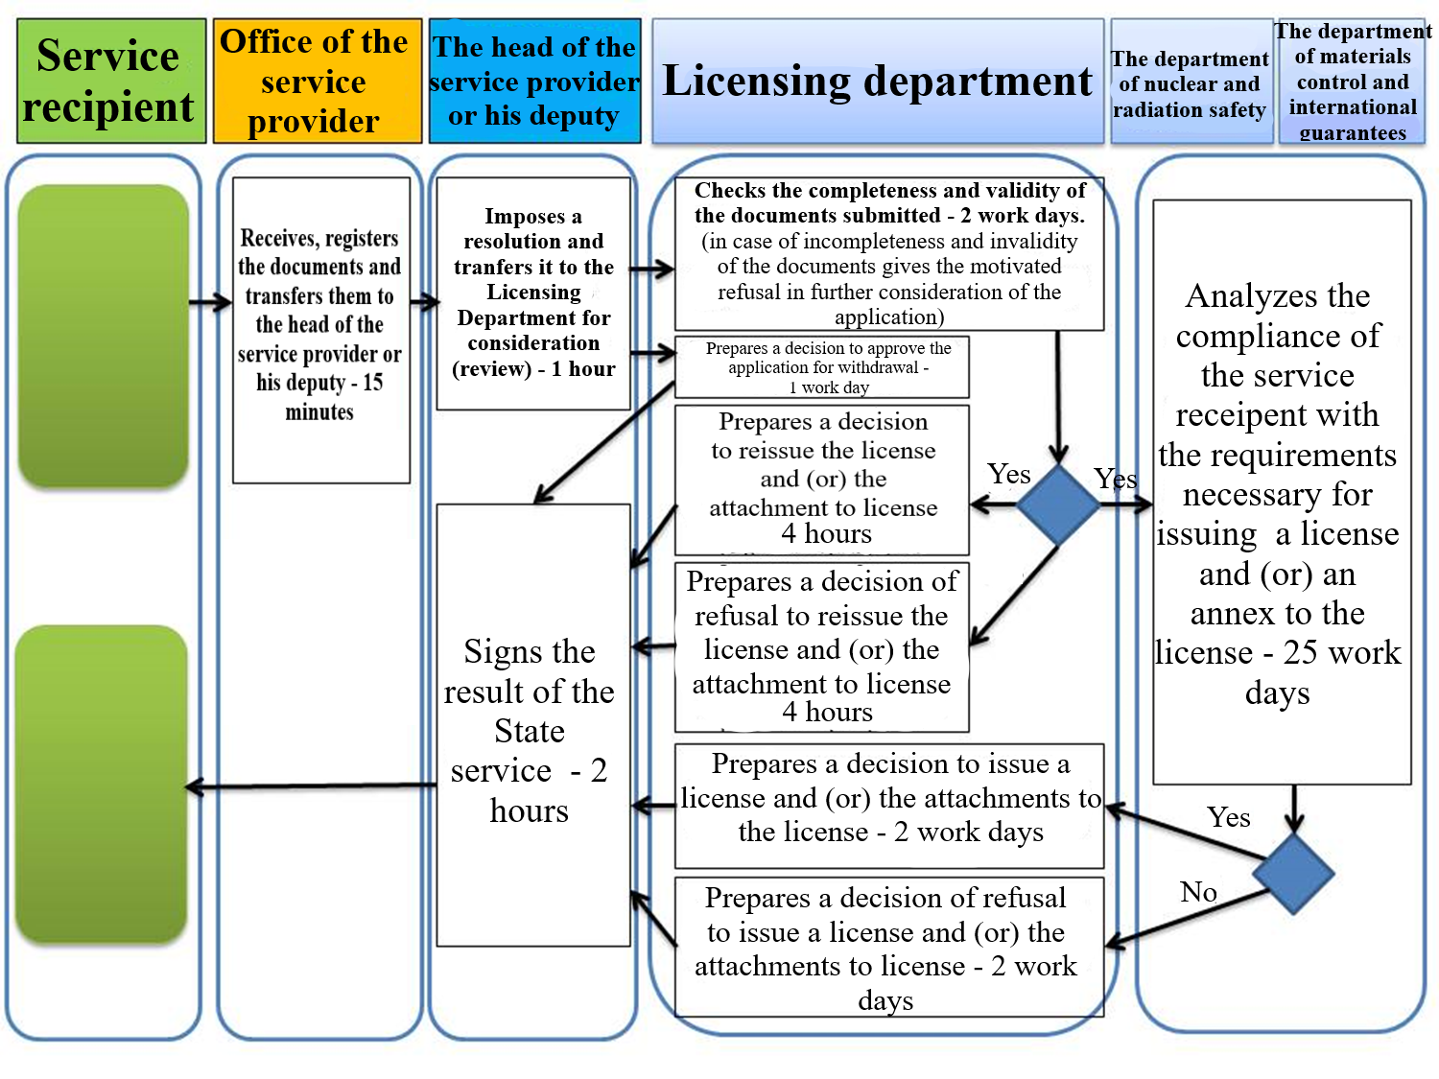

Slide 15
EXPERTISE OF NUCLEAR AND RADIATION SAFETY AND NUCLEAR SECURITY
Expertise of nuclear and radiation safety and of nuclear security shall be carried out for independent assessment of the safety of nuclear installations, radiation and electrophysical installations of radiation hazard categories 1 and 2, transport packages for the entire period, during which they may pose a potential hazard.
The frequency of Expertise of nuclear and radiation safety and nuclear security shall be once every three years.
Expertise of nuclear and radiation safety and nuclear security shall be carried out by organizations accredited by the authorized body for implementation of this type of activity.

Slide 16
EXPERTISE OF NUCLEAR AND RADIATION SAFETY AND NUCLEAR SECURITY
Register of accredited organizations carrying out expertise in nuclear, radiation and nuclear security
№ | Name of the organization | Certificate Issue Date | Certificate expire Date
1 | National Nuclear center of the Republic of Kazakhstan | 25/10/2018 | 26/10/2021
2 | Institute of Nuclear physics | 19/12/2018 | 20/12/2021
3 | Association of legal entities in the form of the association "Scientific and Technical Center for the Safety of Nuclear Technologies" | 19/03/2019 | 19/03/2019

Slide 17
EXPERTISE OF NUCLEAR AND RADIATION SAFETY AND NUCLEAR SECURITY
The objects of expertise are:
1) design documentation for the selection of sites and construction of nuclear facilities, radiation and electrical installations of 1 and 2 categories of radiation hazard;
2) design and operational documentation of nuclear installations, radiation and electrical installations of 1 and 2 categories of radiation hazard, transport packaging;
3) design documentation for the technical modernization of nuclear facilities, radiation and electrical installations of 1 and 2 categories of radiation hazard, transport packaging sets;
4) design and operational documentation for the decommissioning of nuclear installations, radiation and electrophysical installations of 1 and 2 categories of radiation hazard, transport packaging sets.

Slide 18
Approval criteria
Approval criteria are the compliance of research nuclear installations with the requirements specified in the Technical Regulations "Nuclear and Radiation Safety" and "Nuclear and Radiation Safety of Research Nuclear Installations", as well as the requirements established by the legislation of the Republic of Kazakhstan in the field of atomic energy use. (THE INFORMATION OF REQIREMENTS WILL BE IN ANNEX)

Slide 19
Thanks for your attention

