Slide 1
Safety Evaluation of
Malaysian Research Reactor
Ms. Nurul Sareeza Azidin
Atomic Energy Licensing Board
Ms. Mazleha Maskin
Malaysian Nuclear Agency
From Regulatory Body Perspective
From Research Institute Perspective

Slide 2
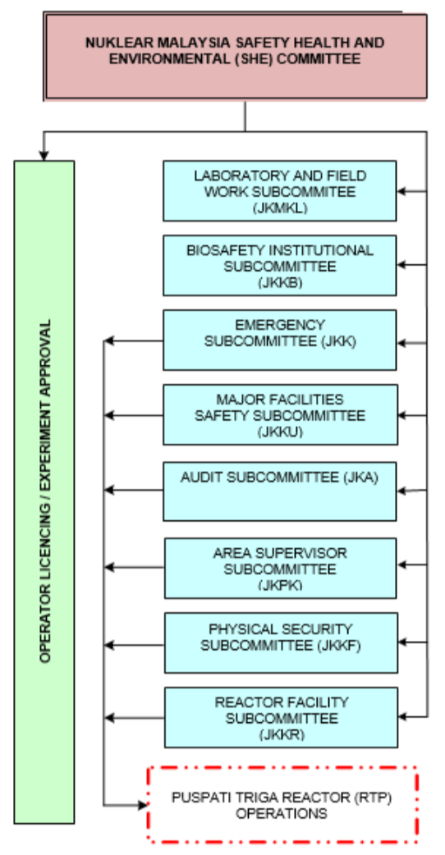
Research Institute Framework for Review and Assessment

Slide 3
Research Institute Framework for Review and Assessment
IAEA Review & Assessment:
  INSARR: Integrated Safety Assessment of Research Reactors (SVS-25)
  ORPAS: Occupational Radiation Protection Appraisals
  IPPAS: International Physical Protection Advisory Service (IPPAS-29)
  ETReS: Nuclear Safety Education & Training Review Service

Slide 4
Experiences in the Application of IAEA Safety Standards [1/3]
Safety Analysis Report
  SSG-20: Safety Assessment for Research Reactors and Preparation of the Safety Analysis Report
Operation:
  SSR-3: Safety of Research Reactors (previously: NSR-4)
  NSG-4.4﻿: Operational Limit and Conditions, and Operating Procedures for Research Reactors
  GSR-3: Radiation Protection and Safety of Radiation Sources
  NSG-4.5: The Operating Organization and the Recruitment, Training and Qualification of Personnel for Research Reactors
  SSG-24: Safety in the Utilization and Modification of Research Reactors

Slide 5
Experiences in the Application of IAEA Safety Standards [2/3]
Maintenance:
  NSG-4.2﻿: Maintenance, Periodic Testing and Inspection of Research Reactor
Strategic Planning
  TECDOC-1212: Strategic Planning for Research Reactors

Slide 6
Experiences in the Application of IAEA Safety Standards [3/3]
Level-I PSA: Internal Initiating Events
  SSG-3: Development and Application of Level 1 PSA for NPP
  50-P-4﻿: Procedures for Conducting PSA of NPP
  TECDOC-400 (1986): PSA for Research Reactors
  TECDOC-719 (1993): Defining IE or Purposes of Probabilistic Safety Assessment
Level-I PSA: Internal Hazard Fire
  SSG-3: Development and Application of Level 1 PSA for NPP: #7.12-7.28
Notes:
7.11: The combination of the probabilities of hazard induced failures of safety related components and independent failures in the Level 1 PSA model will yield the hazard induced core damage frequency

Slide 7
Feedback from IAEA Safety Standards Implementation
Level-1 PSA: Internal Initiating Event
  TECDOC-636: Manual on Reliability Data Collection for Research Reactors PSAs (1992)
  Need to update on components data reliability
Level-I PSA: Procedure/Identification of Internal Hazard Fire, Simulation and Analysis
  Need guideline/procedures for research reactor

Slide 8
THANK YOU

