Slide 1

Canadian Experience in Safety Evaluation of Research Reactors
IAEA-KINS Workshop on Safety Evaluation of Research Reactors 15-19 July 2019
Sang Shim Nuclear Engineering & Systems Analysis Division
Science & Technology
Notes:
For best results, please send the large top image to the back layer. Choose “Arrange” then select “Send to Back”.

Slide 2
Outline
Introduction
Canadian Approach – Safety Principles
Research Reactors – Special Considerations
Safety Analysis – Purpose, Scope, Expectations
Conclusions

Slide 3
What is the concern with the use of nuclear energy?
Nuclear fuel vs fossil fuel
- Fission products
- Radiation
- Radioactive waste (Some have long half lives)

Slide 4
What do we worry about in safety?
Expose or inhale
Release
Contaminate

Slide 5
How do we ensure safety?
Prevent (initiating events, siting consideration, high quality design, manufacturing, operation, redundancy, diversity, separation)
Mitigate (Shutdown systems, ECI, diesel generators, emergency power, emergency water, auxiliary feedwater, other heat sink)
Accommodation (Containment, Emergency Preparedness)

Slide 6
When is safety important?
Siting
Design
Construction
Commissioning
Operation
Maintenance
Decommissioning

Slide 7
How do we ensure safety?
Defence in Depth
Prevention (initiating events, siting consideration, high quality design, manufacturing, operation, redundancy, diversity, separation, safety culture) - Level 1
Mitigation (Shutdown systems, ECI, diesel generators, emergency power, emergency water, redundant heat sink) – Levels 2 and 3
Accommodation (Containment, Emergency Preparedness) – Levels 4 and 5

Slide 8
What are the safety principles used?
Defence-in-depth
Radiation exposure as low as reasonably achievable (ALARA)
Operation within safety envelope (OLCs) based on safety analysis
Periodic safety assessment, and
Safety culture

Slide 9
Canadian Practice with Safety Analysis
Licensees are free to choose the methodology and computer codes
The CNSC does not approve analysis methods or computer codes
Licensees are responsible for their qualification for a given application
Review of the safety analysis is performed by a team of specialists of the CNSC

Slide 10
What is safety analysis?
An estimate of risk in terms of frequencies and consequences of design basis events and design extension conditions that are expected for the research reactor and its associated facilities
A demonstration of the adequacy of the design of mitigating systems to confirm the defence in depth in design
A calculation of impact on safety for changes in the research reactor
If the estimated risk is unacceptable, design and/or operational changes are made until the risk is acceptable.

Slide 11
What are the benefits of safety analysis?
Identify design or operational limits against single failures, common cause failures and other design basis events.
Identify the adequacy of safety features or control options.
Identify a level of risk and safe operating characteristics.
Provide a safe operating envelope (OLCs, technical specifications).
Provide input to commissioning program, operator training program, emergency operating procedures, accident management plan.
Produce confidence on public/worker safety.
Produce a logical basis for making decisions as to what makes most efficient risk reduction.
Provide a legal basis for making licensing decisions.

Slide 12
Designs of Research Reactors
Diverse design for research reactors
  Power level
  Type
  Fuel
Designed for a specific purpose - research or isotope production
Graded approach to meeting safety requirements
Usually designed to provide high neutron flux and high excess reactivity to accommodate samples and targets for irradiation

Slide 13
Special Considerations for
Research Reactors
Reactor power
The amount of fissile and fissionable material
Type of fuel (e.g., fuel meat, cladding, rod or plate type)
The source term
Moderator/reflector
Cooling system (e.g., tank or pool type)
Shutdown system (e.g., one or two)
Containment or confinement
Facilities (e.g., loops, irradiation sites, beam tubes)
Inherent safety features (e.g., natural circulation, excess reactivity, reactivity coefficients, reactivity insertion rate)
Emergency preparedness

Slide 14
Safety Analysis
Deterministic analysis:
  Best-estimate and uncertainties methods
  Conservative, bounding approach
Probabilistic safety assessment (PSA)
Hazard assessment

Slide 15
What is “risk”?
  The basic objective of the Canadian regulator (CNSC) is to avoid “undue risk“ or to limit the risk to a "reasonable level" from a nuclear facility. A PSA is a means to quantify the risk.
  Risk = Σ {Si , Fi x Ci}, i = 1, 2, ..., N
    What can go wrong (scenario, Si)?
    How likely is it to occur (frequency, Fi)?
    What will be the outcome (consequence, Ci)?

Slide 16
PSA
A PSA tries to measure the FREQUENCY and CONSEQUENCE of a particular hazard (generally core damage or off-site consequence in terms of public dose) for all credible SCENARIOS.
A unique feature of a PSA is to describe every sequence of events which can lead to fuel damage and subsequent release of radioactivity.

Slide 17
PSA Elements
  Define the purpose and scope
  Initiating event list: systematic review of facility design and past operating experience to identify possible initiating events
  Event tree analysis: develop event tree models to identify which mitigating systems are required to prevent fuel damage or containment breach
  Consequence categories: group event sequences by consequence level into categories
  Fault tree analysis: construct and analyze the fault tree logic models for the mitigating systems identified

Slide 18
PSA Elements (cont’d)
Data base development
Human reliability analysis
Common cause failure analysis
Integration: combine event trees and fault trees together to calculate the frequency for each consequence category
Calculate consequence for each consequence category
Calculate risk
Perform importance/uncertainty/sensitivity analyses

Slide 19
PSA Levels
There are three levels of PSA:
    Level 1: determination of core damage frequency (containment failure not included)
    Level 2: determination of external release frequency (containment failure included, but no dispersion)
    Level 3: evaluation of public health risk (in terms of dose rate, or cancer rate, or death rate) (dispersion included)

Slide 20
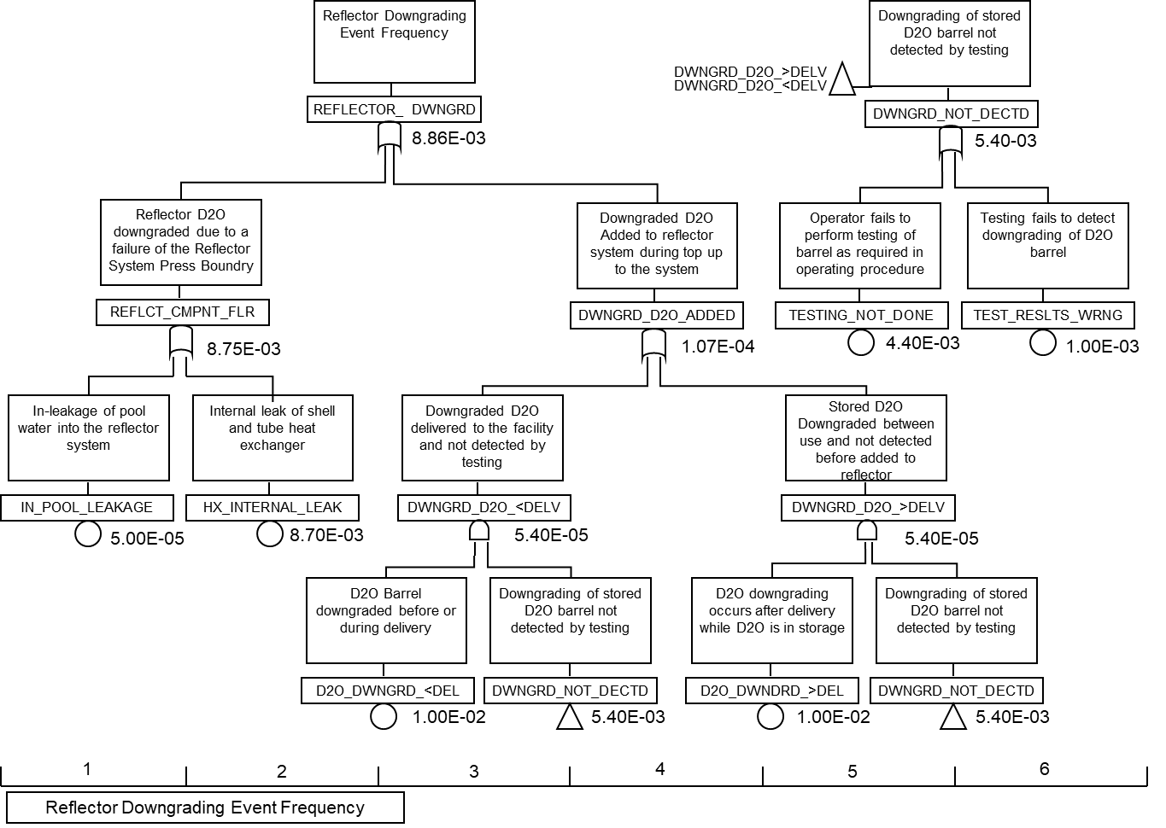
Fault Tree – Reflector Downgrading

Slide 21
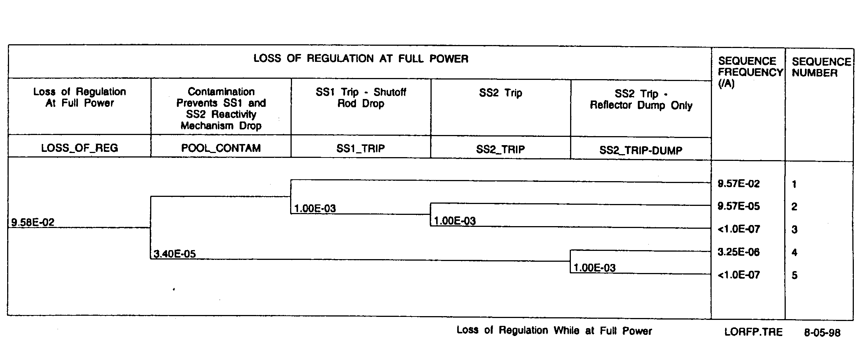
Event Tree
A loss of regulation from full power

Slide 22
Bounding Analysis
A “conservative” analysis is performed so that it can bound:
    All events
    Similar events
    Core configurations
    Operating parameter uncertainties
    Modelling uncertainties
    Conservative assumptions (e.g., least effective shutdown system with least effective trip parameter credited, minimum allowable performance standards (MAPS) for safety systems, 2 of 3 shutoff rods credited, no credit for process systems)

Slide 23
Bounding Analysis (cont’d)
An usual practice is to simulate a bounding event for each derived acceptance criterion (e.g., subcriticality margin assessment with a fuelling error) with a limiting core condition (e.g., the worst flux distribution) and with
conservative assumptions (e.g., the worst reactivity coefficients).
A limiting core is selected and justified for each event (an initial core, transition cores, to an equilibrium core, core fuelling cycle).

Slide 24
Best-Estimate and Uncertainty Analysis
  Best-estimate analysis uses best-estimate codes and does not necessarily consider the most limiting facility state or configuration
  Uncertainty analysis is a necessary complement to best-estimate analysis providing the sensitivity of results to modeling or operating variations
  Uncertainty
    Systematic uncertainty (bias)
    Random uncertainty (error)

Slide 25
Steps in Best-Estimate and Uncertainty Analysis
  Select an initiating event.
  Select a reference operating state.
  Select output parameters of safety concern.
  Rank/select phenomena and parameters of importance.
  Range/quantify uncertainties associated with input parameters. (operating, design, modelling parameters)
  Run codes to perform importance ranking of input parameters. (Some input parameters may be selected at the 95th percentile and others at design center.)
  Run codes to propagate the ranges of uncertainties with input parameters.
  Use the results to derive a response surface.
  Use the results to obtain the range of output parameter (e.g., within 95th percentile).

Slide 26
Benefits of Best-Estimate and Uncertainty Analysis
A best-estimate and uncertainty analysis can:
  Quantify safety margins by using a more systematic approach to operating and modeling uncertainties with best-estimate computer codes.
  Be supported by experiments relevant to conditions of actual accident sequences (cf severe consequences associated with a bounding analysis).
  Help avoid unnecessary economic penalties.
  Help improve operational flexibility.
  Help resolve some ageing issues.
  Provide sound basis for emergency operating procedures, severe accident management guidance, PSA.

Slide 27
Validation Matrix
Identifies phenomena for each accident
Description of phenomena
Ranks these phenomena in importance
Identifies relevant experimental facilities for each of the phenomena (but not specific tests)
Description of experimental facilities (geometry, operating conditions)

Slide 28
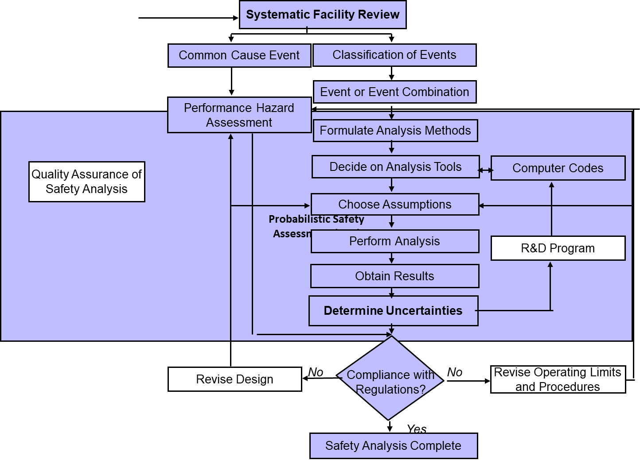
Safety Analysis Process

Slide 29
What do we look for in safety analysis?
In view of three Cs, safety analysis should demonstrate the adequacy of the design
    Control (shutdown effective - depth
    and speed)
    Cooling (adequate cooling – no fuel
    failure)
    Contain (public dose limits – if fuel
    failed)

Slide 30
Acceptance Criteria for Safety Analysis
For DBEs,
No fuel failure
  Exception is an initiating event involving a channel with flow blockage, or defective fuel, or a fuel test designed to fail fuel
Subcriticality with reactor shutdown
Avoidance of prompt criticality
For DECs,
Practical elimination of early or large radiological release

Slide 31
Expectations of Safety Analysis
We consider the following elements for our review:
  Completeness of identifying accident sequences, operating states, phenomena
  Technical soundness of methods, and their validation
  Conservative assumptions
  Safety margins to acceptance criteria
  QA adherence to analysis process
  Consideration of risk arguments (e.g., time at risk)
  Cost-benefit consideration

Slide 32
Systematic Review of a Facility
A systematic review of the site, design, operation and experience of similar facilities should be performed to determine:
  Failure sequences, common-cause events (e.g., fire, earthquake, tornado, flooding, airplane crash), design basis events and design extension conditions
  Safety systems (e.g., shutdown system, containment, emergency power, emergency cooling system)
  Failure modes of safety-related systems (e.g., cross-link effects)
  Operating states (e.g., shutdown, startup, transition, full power, core cycle), and
  Operating parameters (e.g., power, flux shape, burnup, refueling)

Slide 33
Design Basis Events
Initiating events usually selected for design basis for research reactors may include the following:
  Loss of reactivity control (e.g., failure of control rods, erroneous handling of fuel or irradiation targets)
  Loss of coolant (e.g., pipe break)
  Loss of electrical power
  Loss of flow (e.g., pump failure)
  Loss of heat sink
  Channel blockage

Slide 34
Design Basis Events (Cont’d)
Combined events of a process failure with a safety system failure (e.g., shutdown system failure) should be considered
Impact of initiating events in loops and irradiation sites on the core should be considered (e.g., reactivity effects due to installation or removal of an assembly, or coolant voiding in in-core loops, or their effects on flux perturbation and flux detectors)
All events are considered for all permitted operating states
Different situations should be considered:
  Break size and location for a loss-of-coolant case,
  Control rod withdrawal speed, non-uniform withdrawal, rod position, initial power, and initial Xe level for a loss of regulation event.

Slide 35
Safety Analysis Rules
Licensee proposes the rules, the principles and practices
Some of the rules used for research reactor licensing are:
When a reactor has more than one shutdown system, each event is analyzed crediting each shutdown system in turn, and using the least effective trip parameter
Minimum performance values of safety systems should be used
Deterministic assumptions (e.g., 2 of 3 shutoff rods available) are usually used for defence in depth
Each event should be analyzed with or without crediting actions of process systems
Operator actions may be credited when clear link exists between operator actions and operating procedures

Slide 36
Safety Analysis Rules (cont’d)
Analysis methods and models used should:
Represent underlying physics and capture all important physical phenomena
Be validated for their applicability and accuracy against relevant data
Input parameters should give conservative predictions of consequences of each event
Take into account uncertainties associated with each parameter
Choose empirical correlations that are conservative
Justify scaling of results beyond the range of experimental data
Each event should be analyzed for most severe operating state
Consequences of an event (e.g., flooding) for the performance of safety-related systems (e.g., electrical power) should be considered

Slide 37
Analysis Methods
Licensees are free to choose methods and computer codes, i.e., CNSC does not approve analysis methods or computer codes
Review of the safety analysis is performed by CNSC specialists
Licensees are responsible to make a case for a given application
Usual practice: simulate a bounding event for each derived acceptance criterion (e.g., subcriticality margin assessment with a fueling error) for a limiting core condition (e.g., the worst flux distribution) and for conservative assumptions (e.g., the worst reactivity coefficients)
A limiting core should be selected and justified for each event (an initial core, transition cores, to an equilibrium core, core fueling cycle)

Slide 38
Analysis Methods (cont’d)
Applicability and accuracy of chosen codes should be clearly demonstrated. In particular, this concerns analysis methods and computer codes adapted from power reactors
For example:
  Applicability of a point-kinetics model for a core with non-uniform deployment of reactivity devices
  Applicability of empirical models (e.g., boiling curve, pressure drop) to different geometries for irradiation samples and targets
  Component and system models

Slide 39
Computer Code Validation
CNSC expectations given in G-149
Include safety analysis and operational support codes
Demonstrate applicability and accuracy of each code for phenomena in a particular event
Consider computer code sensitivities, limitations and uncertainties for each selected application
Data from: out-of-reactor tests as well as commissioning tests, in-reactor tests or operational data
Quantify uncertainties to show adequate safety margins to derived acceptance criteria for all design basis events

Slide 40
Probabilistic Safety Assessment (PSA)
Our licensing is based on both deterministic safety analysis and PSA required for research reactors
Benefits of performing PSA:
Provide a logical basis for deciding on most efficient risk reduction
Confirm failure sequences identified by systematic review of a facility
Identify failure sequences dominating cumulative frequency of serious process failures
Identify design weaknesses of a facility
Identify failures dominating unavailability of each safety-related system

Slide 41
Update of Safety Analysis
Safety report update: ensure that the safety analysis remains valid during licence term and that facility is operating within operating limits and conditions
The safety report update is one of the requirements for licence renewal
Reasons for updating safety analysis periodically:
  New R&D findings
  Tests proposed for a nuclear facility
  Changes in design, operating envelope and operating procedures
  New information from commissioning and operating data from similar facilities
  New safety standards and analytical methods

Slide 42
Conclusions
Canadian practice is given on safety analysis of research reactors.
This practice reflects Canadian experience and knowledge on the safety analysis, computer codes and acceptance criteria and is comprehensive.
Canadian regulator, CNSC considers each research reactor application individually to determine the scope and details of the safety analysis. The reasoning is that each research reactor is unique and has is own specific issues that must be addressed.

